Slide 1

HDL Towards a Harmonized Dataset Model for Open Data Portals
Ahmad Assaf, Raphaël Troncy And Aline Senart

Slide 2
Open Data/Linked Open Data
Open Data (OD) is the data that can be easily discovered, accessed, reused and redistributed by anyone [Davies et al. 2014]
Open Data should be placed in public domain under liberal terms of use and available in electronic formats that are non-proprietary and machine readable.
Linked Open Data (LOD) refers to the semantically rich, linked and machine readable open data.
Open Data has major benefits for citizens, businesses, societies and governments.
HDL Towards a Harmonized Dataset Model for Open Data Portals

Slide 3
Metadata
Metadata is structured information that describes, explains, locates or otherwise makes it easier to retrieve use or manage information resources
Data Discovery, exploration and reuse
Organization
&
identification
Archiving
&
preservation
HDL Towards a Harmonized Dataset Model for Open Data Portals

Slide 4
Data Portals/Data Management Systems
Data Portals (Catalogs) are the entry points to discover published datasets
Data Portals are a curated collection of datasets metadata providing a set discovery and integration services.
Data Portals can be private like datahub.io, publicdata.eu or private like enigma.io or quandle.com
Portals are built on top of Data Management Systems (DMS) like CKAN, DKAN and Socrata
HDL Towards a Harmonized Dataset Model for Open Data Portals

Slide 5
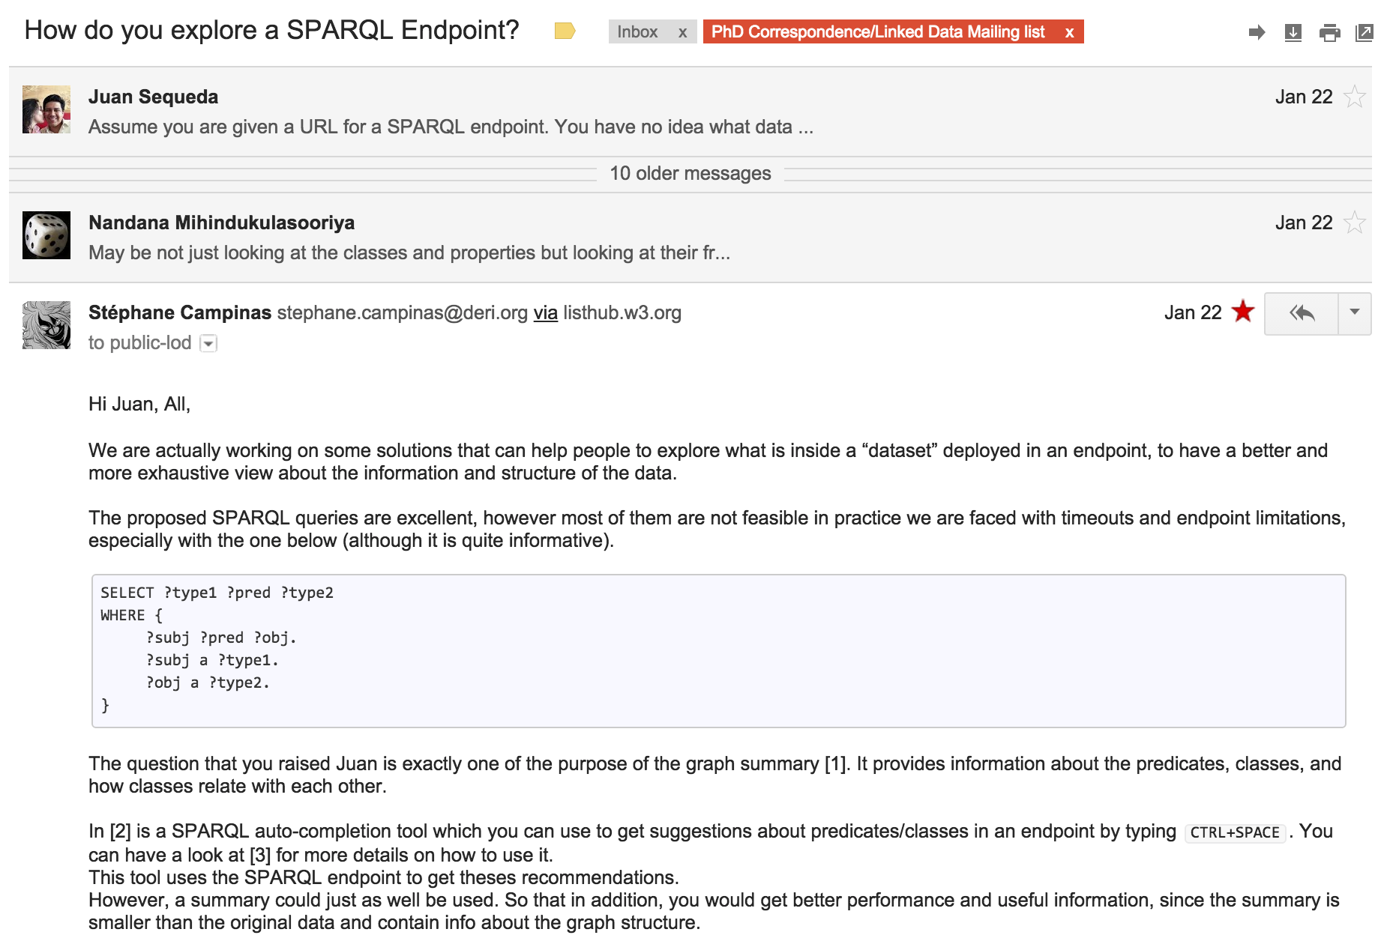
Why a Harmonized Model ?
Exploring/discovering datasets for (re)use
Defining a “minimal” set of information needed to build a “profile”
Building tools that will automatically generate/validate metadata models
HDL Towards a Harmonized Dataset Model for Open Data Portals

Slide 6
Dataset Models - DCAT
The Data Catalog Vocabulary (DCAT)✝ is a W3C recommendation to facilitate interoperability between data catalogs on the web
DCAT is an RDF vocabulary with three main classes: dcat:Catalog, dcat:Dataset and dcat:Distribution
DCAT Profiles [extensions built upon DCAT]
DCAT-AP✝✝ defines a minimal set of properties that should be included in a datasets profile by specifying mandatory and optional properties
The Asset Description Metadata Schema (ADMS)✝✝✝ is used to semantically describe assets (code lists, taxonomies, vocabularies)
✝ http://w3.org/TR/vocab-dcat/
✝✝ https://joinup.ec.europa.eu/asset/dcat_application_profile/description
✝✝✝ http://www.w3.org/TR/vocab-adms/
HDL Towards a Harmonized Dataset Model for Open Data Portals
Notes:
An asset is something that can be opened and read using a familiar desktop software as opposed to the need to be processed like raw data.

Slide 7
Dataset Models - VoID✝
RDF vocabulary for interlinked datasets
In addition to describing datasets, VoID describes the links between datasets
VoID defines three main classes: void:Dataset, void:Linkset and void:subset
A linkset in voiD is a subclass of a dataset, used for storing triples to express the interlinking relationship between datasets
✝ http://www.w3.org/TR/void/
HDL Towards a Harmonized Dataset Model for Open Data Portals
Notes:
The interlinking is modelled by a linkset (void:Linkset). A linkset in voiD is a subclass of a dataset, used for storing triples to express the interlinking relationship between datasets. In each interlinking triple, the subject is a resource hosted in one dataset and the object is a resource hosted in another dataset. This modelling enables a flexible and powerful way to talk in great detail about the interlinking between two datasets, such as how many links there exist, which kind of links (e.g. owl:sameAs or foaf:knows) are present, or stating who claims these statements.

Slide 8
Dataset Models – CKAN✝/DKAN✝✝
Data model describes a set of entities (dataset, resource, group, tag)
Allow additional information to be added via “extra” arbitrary key/value fields
The core metadata restricted as a JSON file
Supports Linked Data and RDF by providing a complete and functional mapping of its model to LD formats
CKAN support descriptions of vocabularies
DKAN is a Drupal based DMS
✝ http://ckan.org
✝✝ http://demo.getdkan.com/
HDL Towards a Harmonized Dataset Model for Open Data Portals

Slide 9


Dataset Models - Continued
✝
✝✝
✝✝✝
Commercial platform to streamline data publishing, management, analysis and reusing.
The model is designed specifically to represent tabular data
The model covers a basic set of metadata properties and has good support for geospatial data
A collection of schema used to markup HTML pages with structured data
Covers many domains. We are interested in the Dataset schema although we also use various properties from schemas like organizations, authors, etc.
Online collection of best practices and case studies to help data publishers
POD data model is based on DCAT
Similarly to DCAT-AP, POD defines three types of metadata elements: Required, Required-If and Expanded(optional)
Metadata extensions using elements from the “Expanded” fields
✝ http://socrata.com
✝✝ http://schema.org
✝✝✝ https://project-open-data.cio.gov/
HDL Towards a Harmonized Dataset Model for Open Data Portals

Slide 10
Ballmer effect anyone?
https://xkcd.com/323/
HDL Towards a Harmonized Dataset Model for Open Data Portals

Slide 11
Metadata Classification – Information Groups
Resource
Tag
Group
Organization
Actual raw data that can be downloaded or accessed directly e.g. JSON, CSV, SPARQL endpoint
Descriptive knowledge about the dataset contents and structure. This can range from simple textual tags to semantically rich controlled terms
Organizational units that share common semantics. They can be seen as a cluster or curation based on shared themes/categories
Clustering or curation solely based on associations with specific administration parties
HDL Towards a Harmonized Dataset Model for Open Data Portals

Slide 12
Metadata Classification – Information Types
General Information
Geospatial Information
title, description, id
bbox, layers
Access Information
Temporal Information
URL, license_title, license_id
coverage_from, coverage_to
Ownership Information
Statistical Information
Dataset Metadata
author, maintainer_email
max_value, uniques, average
Quality Information
Provenance Information
rating, availability, freshness
version, creation_date, update_date
HDL Towards a Harmonized Dataset Model for Open Data Portals

Slide 13

Harmonization Process
Examine the model or vocabulary specification and documentation
Examine existing datasets using these models
Examine the source code for DMS
HDL Towards a Harmonized Dataset Model for Open Data Portals

Slide 14
Extra Information
HDL Towards a Harmonized Dataset Model for Open Data Portals

Slide 15
https://xkcd.com/927/
HDL Towards a Harmonized Dataset Model for Open Data Portals

Slide 16
seek, and ye shall find
Questions?
Ahmad Assaf
http://ahmadassaf.com
@ahmadaassaf
http://github.com/ahmadassaf
HDL Towards a Harmonized Dataset Model for Open Data Portals

